Slide 1
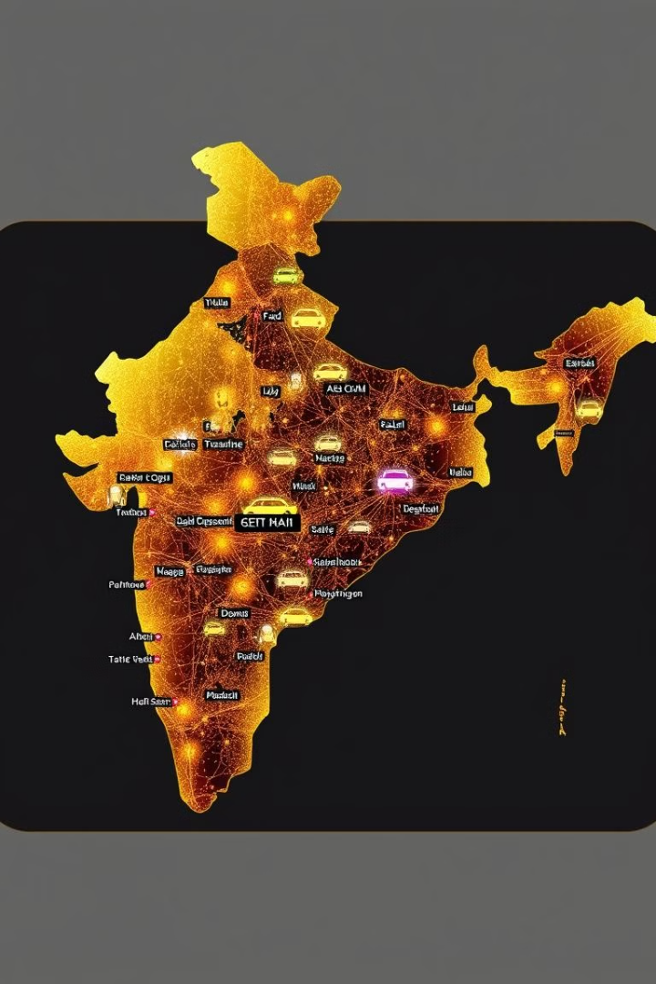
Deep Dive into Ola Customer Purchase Behavior
This presentation analyzes customer purchase behavior for Ola, a leading ride-hailing service in India. We'll explore key trends, patterns, and insights that drive Ola's customer base and inform future growth strategies.

Slide 2
Understanding the Customer Journey
Booking and Payment
Ride Experience
Post-Ride Engagement
Analyze booking methods, average ride duration, and payment preferences, identifying common customer patterns and optimizing the booking process.
Assess customer satisfaction levels, identify key factors influencing ride quality (e.g., driver behavior, vehicle condition), and track customer feedback.
Explore customer retention strategies, identify opportunities to encourage repeat bookings, and analyze post-ride surveys for feedback and improvement areas.

Slide 3
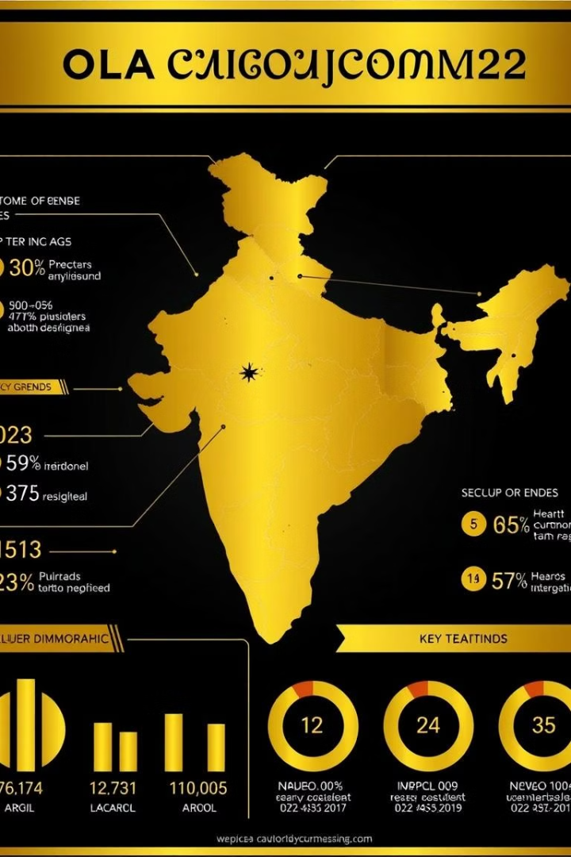
Demographic Analysis of Customers
1
Age Distribution
2
Gender Segmentation
Identify the dominant age groups using Ola services. This helps target marketing campaigns and optimize app features for specific demographics.
Analyze gender-based usage patterns to better understand service preferences and tailor marketing messages accordingly.
3
Location-Based Trends
Discover regional variations in customer behavior, facilitating tailored promotional strategies for different regions.

Slide 4
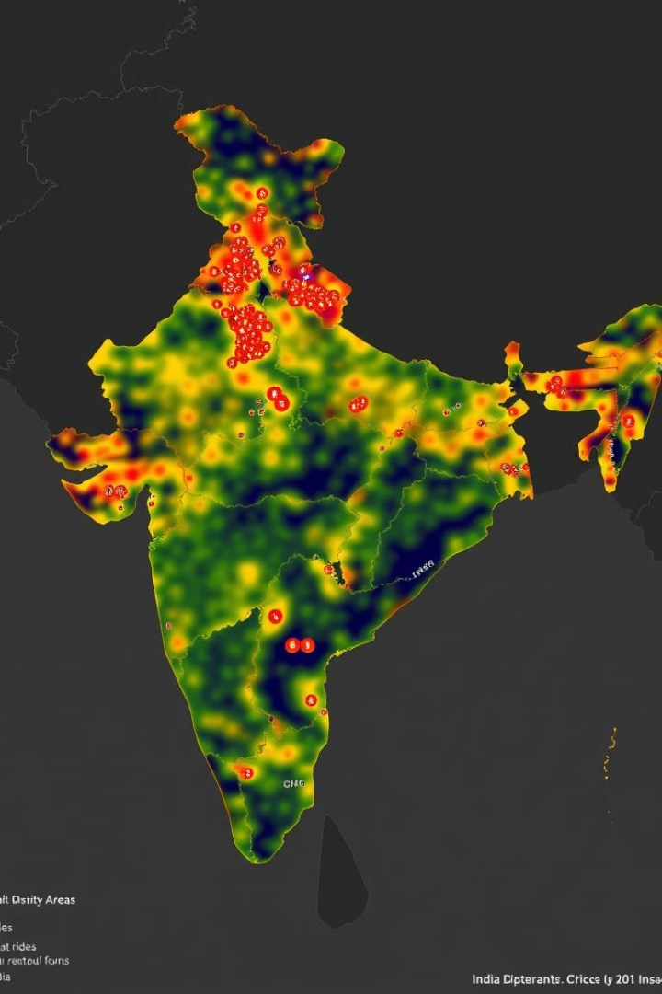



Geo-spatial Analysis of Customer Locations
Ride Density
Analyze geographic patterns of ride activity to identify areas with high demand, allowing for optimized fleet management and efficient resource allocation.
Peak Hours
Identify peak travel times for different areas, enabling dynamic pricing strategies to cater to fluctuating demand.
Growth Potential
Identify underserved areas with potential for expansion, allowing Ola to expand its service footprint and cater to a wider customer base.

Slide 5
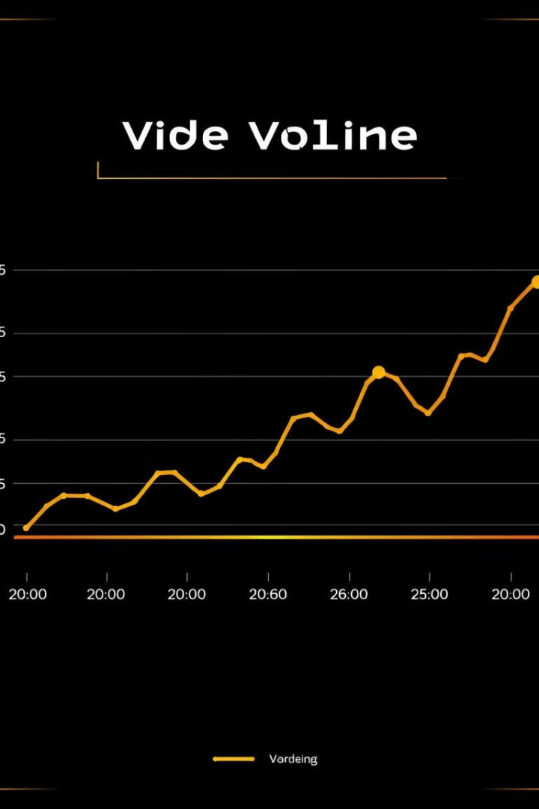
Time-series Analysis of Purchase Patterns
1
Seasonal Trends
Identify seasonal fluctuations in ride demand to optimize staffing and resource allocation for peak periods.
2
Daily/Weekly Patterns
Analyze day-of-the-week and time-of-day variations in ride usage to optimize pricing and promotions for different periods.
3
Holiday Impact
Assess how holidays affect ride demand, allowing for proactive adjustments in pricing and service availability during peak periods.

Slide 6
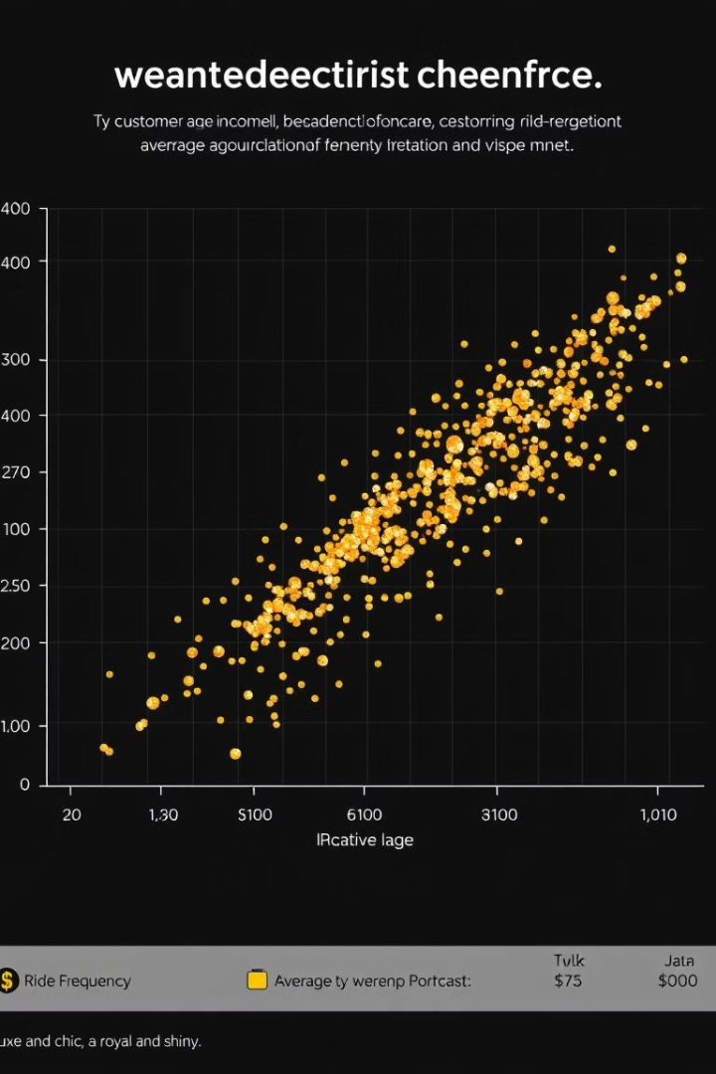



Correlation between Customer Attributes and Purchases
Age and Ride Frequency
Identify whether certain age groups exhibit higher ride frequency, allowing for tailored marketing strategies for specific age brackets.
Income and Ride Cost
Analyze the relationship between income level and average ride cost, informing pricing strategies and identifying potential customer segments.
Location and Ride Type
Explore correlations between customer location and preferred ride types (e.g., auto, bike), enabling targeted promotions for different regions.

Slide 7




Predictive Modeling of Customer Churn
1
Predictive Modeling
Identify Factors
2
Analyze key factors contributing to customer churn, such as ride frequency, satisfaction levels, and payment patterns.
Early Detection
3
Develop predictive models to identify customers at risk of churning, allowing for timely intervention strategies.
Retention Strategies
4
Implement targeted retention campaigns and personalized offers to prevent customer churn and improve overall customer loyalty.

Slide 8
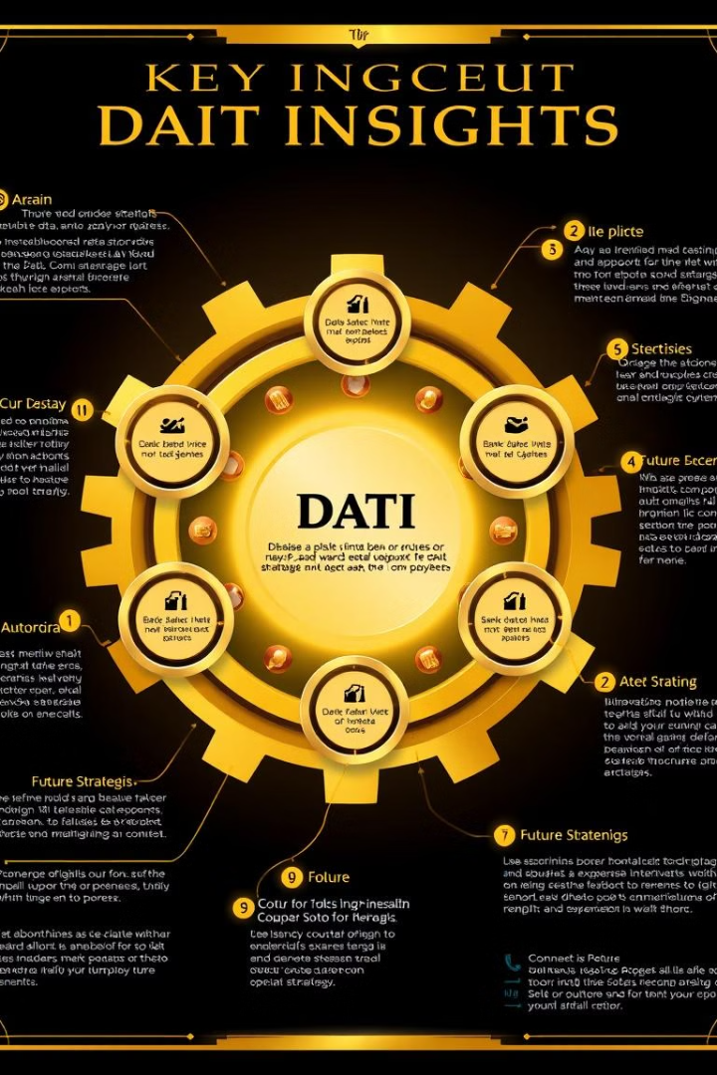
Key Insights and Recommendations
1
Targeted Marketing
Leverage demographic and geo-spatial insights to personalize marketing campaigns and promotions.
2
Dynamic Pricing
Implement dynamic pricing models based on time-series data to optimize revenue during peak periods.
3
Customer Retention
Proactively address customer churn by identifying at-risk customers and offering targeted retention strategies.

Slide 9
Data Analyzers
Gaurav Gupta
Ganesh Tiwari
Om Dubey
Data analyst with a passion for uncovering hidden insights in complex datasets. Contributed to the analysis of customer demographics, ride frequency, and churn prediction models.
Data scientist specializing in time-series analysis. Identified seasonal trends, daily patterns, and holiday impacts on ride demand, providing valuable insights for operational optimization.
Data engineer responsible for building and maintaining the data infrastructure that powered the analysis. Contributed to data pipeline optimization, ensuring data quality and timely access.

